Slide 1
Tools of the Trade
An overview of applications for district data coordinator use

Slide 2
Tools of the Trade
SEDREF
SEDDAS
Application Business Portal
Data.nysed.gov
Level 0 Historical
L2RPT (Level 2)
WNYRIC Regional Data Warehouse (Level 1)
Level 0
ASAP
Monroe SFTP

Slide 3
SEDREF
State Education Department Reference File
Publicly Available Database of NYS Institutions
Districts & BOCES
Charter schools
Non-public schools
Approved Pre-School Programs
Approved School-Age Special Ed Programs
Information in SEDREF
Institution code
BEDS code
Administrative Positions
Institution Type
CSE Placement Eligible
SEDREF COGNOS Reports
Preschool Approved Special Education Programs
School-Age Approved Special Education Programs
SEDREF is used as the source by NYSED for LEA contacts
If your contacts in SEDREF are not updated, then your school might not be getting important information and memos from NYSED
SEDREF Main Information Page
https://www.oms.nysed.gov/sedref/
SEDREF Search Page
https://portal.nysed.gov/abp

Slide 4
SEDREF Query
Each District and school has its own Institution ID and SED Code
Greece CSD:
Inst. ID 800000051588
SED Code: 260501060000
Odyssey
Inst. ID: 800000051555
SED Code: 260501060013
Search Tips
use “%” as a wildcard​
County Code = “26” for MONROE county​
Inactive Ind: = “N” to show only active locations​

Slide 5
SEDREF Administrative Positions
Administrative Positions
Chief Executive Officer (SEDDAS)
3-8 Testing Coordinator (DTC)
NYSAA Testing Coordinator (KITE)
Information Officer (DDC)
Principal (Exam Request)
Used by NYSED to send emails to primary contact
SEDDAS Admin is CEO in SEDREF

Slide 6
SEDREF Changes
SEDREF Main Information Page: https://www.oms.nysed.gov/sedref/
Provides instructions for changing information in SEDREF
Changes in SEDREF
Send request on Institution’s letterhead to datasupport@nysed.gov
Must include
School BEDS code
Email address and phone number of new individual
Effective date of the change
Signature of current superintendent or principal
Nonpublic schools must use CFO form found on SEDREF main page to change CFO

Slide 7
SEDDAS
State Education Department Delegated Account System (SEDDAS)
Create and manage accounts for NYSED web-based applications
CEO identified in SEDREF is the Super/CEO Delegated Administrator for SEDDAS
SEDDAS Roles
Super/CEO Delegated Administrator – can create other roles in SEDDAS (Superintendent/CEO)
Delegated Administrator – can create accounts for users
Entitlement Administrator – can create entitlements for users
Delegated Account/Entitlement Administrator – can create accounts and entitlements for users
SEDDAS User Guides: https://www.p12.nysed.gov/seddas/seddashome.html
SEDDAS Support Information: https://datasupport.nysed.gov/hc/en-us/articles/218069963-NYSED-Office-of-Information-and-Reporting-Services-Web-Applications

Slide 8
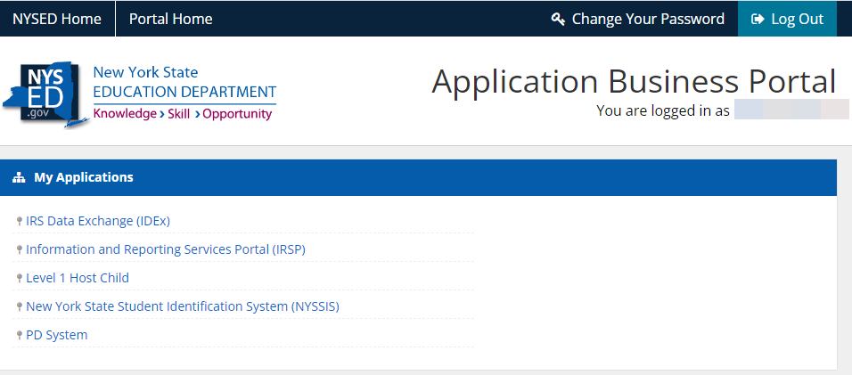
SEDDAS
Systems SEDDAS manages access to:
Application Business Portal
IRS Data Exchange (IDEx)
Information and Reporting Services (IRSP)
New York State Student Identification System
NYSSIS State Match Child Nutrition
PD System
Exam Request System
SED Monitoring & Vendor Performance
L2RPT
Level 0 Historical
Data.nysed.gov
Change Your Password using link at top of Application Business Portal
Changes password for ALL SEDDAS applications including L2RPT

Slide 9
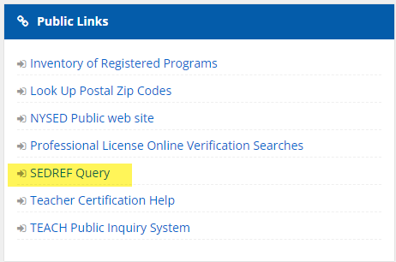
Application Business Portal
https://portal.nysed.gov/abp/
Access to most SEDDAS applications is through the Application Business Portal
Use your SEDDAS account to login
My Applications includes a list of applications to which you have been given SEDDAS entitlements
Public Links includes a list of publicly available applications
SEDREF Query
NYSED Public web site

Slide 10
My Applications
IRS Data Exchange (IDEx)
EOY Certification form
School Safety & Educational Climate form
BEDS IMF – District Data Form
Information and Reporting Services (IRSP)
Teacher Course to Certification Crosswalk
Preliminary ESSA Determinations
Long Term Goals & Measures of Interim Progress (MIPS)
9-12 Grades Growth Results
New York State Student Identification System (NYSSIS)
Assigns a NYSSIS ID to each student or matches them with their existing NYSSIS ID
District users resolve “holds” when system is unsure
PD System (Pupils with Disabilities)
Special Education reporting system
VR Reports for BEDS Day and End of Year
Sp. Ed. Events
Special Education Director certifies data in this system
SED Monitoring & Vendor Performance System
APPR
APPR Plan
Staff Evaluation Certification form
MVPS
Exam Request System
Principals use this system to order 3-8 and Regents tests

Slide 11
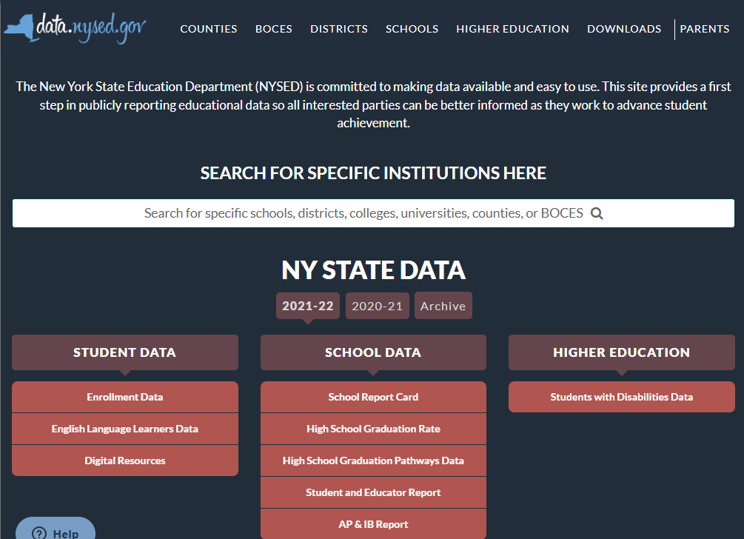
data.nysed.gov
Public Data Site
Enrollment Data
3-8 ELA & Math Assessment Data
School Report Card
High School Graduation
High School Graduation Pathways
Student & Educator Report
Financial Transparency Report
AP & IB Report
Downloads
Databases of all public data
Login
To access embargoed data
Link at bottom of page under Additional Information
In SEDDAS must have ‘Data View’ entitlements to ‘IRS Data” application

Slide 12
Level 0 Historical
https://l0historical.nyseddata.org/
Used to update prior school year records in L2RPT
Data areas available for view and update
Demographics
Enrollment
Program Fact
Assessment Fact
You can only update student data in a school year that the student attended your school.
You cannot add a new student to Level 0 Historical
Help for Updating Student Data in Level 0 Historical: https://l0historical.nyseddata.org/help.aspx?page=studentdata&edit=true

Slide 13
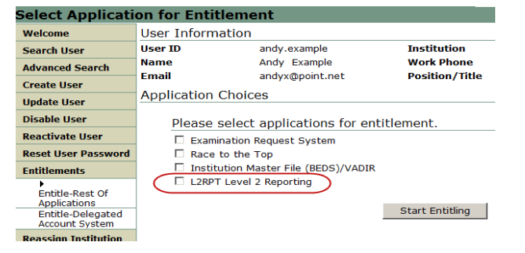
L2RPT
https://dwdataview.wnyric.org/
L2RPT is Level 2
Accounts are created in SEDDAS and require entitlements to L2RPT
https://www.p12.nysed.gov/seddas/guides/l2rpt-quick-guide.pdf
There are five roles for L2RPT:
Free and Reduced Lunch: this Role grants access to the Free and Reduced Price Lunch Eligibility verification report.
L2RPT: this Role grants access to verification reports containing student enrollment, demographic, assessment and course data for accountability, assessments, enrollment, CTE, WATN, TSDL.
Staff Evaluations: this Role grants access to the Staff Evaluation verification report.
Staff Human Resource Data: this Role grants access to verification reports containing staff data other than evaluation that may be viewed as human resource related (Staff Snapshot, Staff Tenure).
Staff Data – Other: this Role grants access to verification reports containing staff data other than human resource and evaluation.

Slide 14
WNYRIC Regional Data Warehouse
https://dwdataview.wnyric.org/
WNYRIC Regional Data Warehouse is Level 1
Each district & charter school has 3 user accounts available
Additional user accounts can be added for a nominal fee
To set up a user account contact Laurie Hazard at lhazard@bocesmaars.org or Matt Fredericks at mfrederi@bocesmaars.org
New users require a Data Warehouse Security Form signed by your superintendent or charter school leader

Slide 15
Level 0
https://level0.monroe.edu/
Web application used to report SIRS data
District Data Coordinators are also Level 0 Security Officers and can create user accounts within the application for users in their district/school
New DDCs need to submit a signed Level 0 Security Officer Form to Matt Fredericks at mfrederi@bocesmaars.org before an account can be created for them
A Level 0 Security Officer Form must be completed each school year in order to maintain access to Level 0.
If you need to add a location in Level 0, contact Matt Fredericks or Laurie Hazard with
Name of school
BEDS code or Institution Id

Slide 16
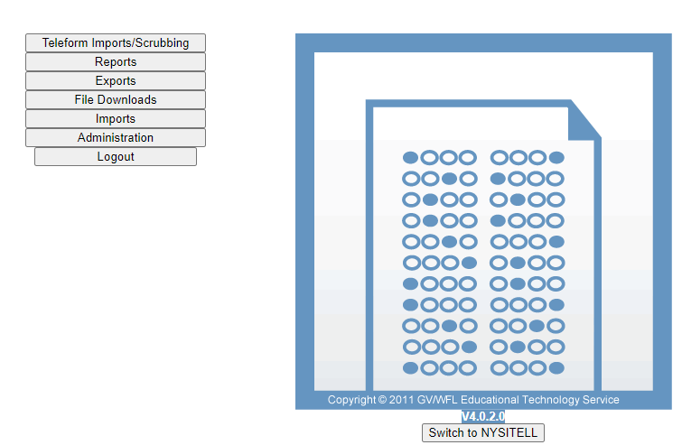
ASAP
Assessment Scoring and Analysis Program: https://asap.monroe.edu/
Web application used to score NYSITELL and Regents exams
Accounts for ASAP are created in Level 0
Use Level 0 account to log in

Slide 17
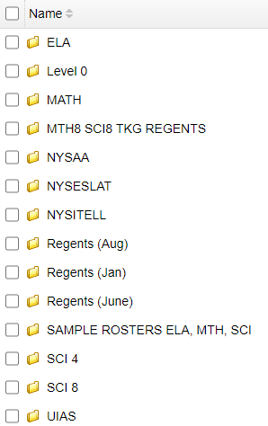
Monroe SFTP
https://files.monroe.edu/login
A secure means of sharing files with PII and other sensitive data
Contact Mari-Ellen Maloney at mmaloney@bocesmaars.org to set up an account
FileZilla: https://filezilla-project.org/

Slide 18
Questions?

